Slide 1
INSTRUCTIONS
Use Font size 22 to 28 and Font Style Times New Roman (body)
Do not change the Template: Heading / Title of the slides
Do not change font style or colours
Do not copy paste paragraphs: use only Bullet Points
Maximum slide Limit is 20 only
As per the number of supervisor allotted adopt slide-2 or slide-3
Please display the required meaningful Content or images or tables
Change the footer accordingly using insert tab then click on header & footer tab and edit it
Save the PPT with Register No, Dept and Review no, example: 23xxxxxxxxx_CSE

Slide 2

Title: Digital Commerce Platform with Administrative Control (DCPAC)
Student Name: M Susheel Rao
Student ID: 2520080064)
Cluster: 3
Section: 11
Under the Guidance
of
Supervisor Name: Mrs.Surekha
Assistant Professor
Department of CSE

Slide 3
OUTLINE
Abstract
Existing System
Proposed System
System Architecture
Project Modules
Objectives
Co’s Attainments - FWD
Co1
Co2 …….. 5. Co5
Co’s Attainments - DSA
Co1
Co2 …….. 5. Co5
Screen Shots for FWD & DSA
Conclusion
Geo-Tagged Photos

Slide 4
Abstract
DCPAC (Digital Commerce Platform with Administrative Control) is a full-featured e-commerce web application developed as a Project-Based Learning initiative.
The platform allows customers to browse, search, filter, and purchase products across 8 categories: Electronics, Fashion, Home, Sports, Beauty, Books, Toys, and Grocery (45+ products).
An integrated Admin Dashboard enables product management (CRUD), order tracking, user management, inventory monitoring, and revenue analytics.
The system implements secure user authentication with session management, coupon/promo code engine, multi-payment gateway (Card, UPI, Net Banking, COD), and real-time order tracking.
Built with HTML5, CSS3, and Vanilla JavaScript using localStorage for client-side persistence — scalable to Node.js + MongoDB backend.
The project demonstrates real-world software engineering: SPA routing, MVC separation, responsive UI/UX, and modular 3-file code structure (index.html + dcpac-styles.css + dcpac-app.js).

Slide 5
Existing System
Problems with Existing E-Commerce Platforms:
Platforms like Amazon and Flipkart are enterprise-scale and too complex to replicate or customize for learning and academic projects.
No lightweight, open-source commerce platform with a built-in admin panel exists for student or self-learning environments.
Admin dashboards in existing systems are separate enterprise tools — not integrated within the commerce application itself.
Existing platforms lack transparent order tracking, coupon management, and a simple multi-payment flow suitable for learning.
Off-the-shelf solutions offer very limited UI/UX customization, restricting what students and developers can build and explore.

Slide 6
Proposed System
DCPAC — Digital Commerce Platform with Administrative Control proposes:
A fully functional e-commerce SPA built with HTML, CSS and JS
45-product catalogue across 8 categories (Electronics, Fashion, Home, Sports, Beauty, Books, Toys, Grocery) with dynamic filtering and search.
Complete purchase flow: Home → Browse → Product Detail → Cart → Coupon → Payment (Card/UPI/Net Banking/COD) → Order Confirmation → Tracking.
Integrated Admin Dashboard with product CRUD, order and user management, inventory visibility, and revenue analytics.
Secure authentication with login/register, localStorage session persistence, role-based UI updates, and demo account support.
Responsive UI/UX design with custom cursor, particle animations, real-time search dropdown, and toast notifications.

Slide 7
System Architecture
Presentation Layer (Frontend — Browser):
index.html — SPA shell with 10 page sections
dcpac-styles.css — Complete design system (CSS variables, animations, responsive breakpoints)
KL University template branding maintained throughout
Business Logic Layer (JavaScript — dcpac-app.js):
SPA Router (P() function) — 10 pages, no page reload
Cart Engine, Filter/Search Engine, Auth Manager, Coupon & Payment Logic
Canvas API particle system, real-time DOM manipulation
Data Layer (Browser Storage — localStorage):
cart[], users[], orders[] arrays — all persisted across sessions
session object for active user; DB[] array — 45-product in-memory database

Slide 8
Project Modules
Module 01 — Home & Hero:
Animated particle canvas, product reel, category grid, flash deals bento, trending rows, scrolling ticker.
Module 02 — Product Catalogue:
45-product DB, dynamic filter sidebar (category, price, rating, discount), sort options, live result count.
Module 03 — Product Detail:
Full detail view: image, specs, rating, MRP/discount/savings breakdown, highlights, Add to Cart & Buy Now.
Module 04 — Cart & Checkout:
Cart management (add/remove/qty), order summary, coupon engine (4 codes: DCPAC20, SAVE10, WELCOME15, FLAT50).
Module 05 — Payment Gateway:
4 modes: Card (live card preview), UPI, Net Banking, Cash on Delivery. Full form validation before order placement.
Module 06 — Order & Tracking:
Order ID generation, 5-step animated tracking timeline, delivery partner display, My Orders with reorder.
Module 07 — Authentication:
Sign In/Sign Up, localStorage persistence, session management, role-based UI, demo: demo@dcpac.com / demo123.
Module 08 — Admin Control:
Product CRUD, user list, order status updates, inventory visibility, revenue summary dashboard.

Slide 9
Objectives
Objectives of the DCPAC Project:
Design and develop a fully functional e-commerce SPA using HTML, CSS, and JavaScript without any external framework dependency.
Implement a 45-product catalogue with dynamic multi-criteria filtering (category, price, rating, discount) and real-time live search.
Build a secure user authentication system with login/register, session persistence, and role-based access control using localStorage.
Develop a complete checkout pipeline: Cart → Address → Payment (Card/UPI/NetBanking/COD) → Order Confirmation → Tracking timeline.
Create an integrated Admin Control Panel for product management (CRUD), order tracking, user management, and sales analytics.
Apply responsive UI/UX design across desktop, tablet, and mobile with animations, custom cursor, and toast notification system.
Demonstrate software engineering best practices: modular 3-file structure, SPA routing, and separation of concerns (HTML/CSS/JS).

Slide 10
Co’s Attainments - FWD
CO1 — Apply HTML5 and CSS3 to create structured and styled web pages:
Created index.html with semantic tags: nav, main, section, header, footer across 10 SPA pages.
Built 3-file SPA structure: index.html + dcpac-styles.css + dcpac-app.js.
Applied CSS custom properties (variables) for theming; CSS Grid and Flexbox for responsive layouts.
CO2 — Implement responsive design and advanced CSS techniques:
CSS animations: particle canvas, scrolling ticker, card hover-reveal bars, toast notifications.
Custom cursor with dot + trailing ring; animated hero heading and product reel slide-in effects.
CO3 — Develop dynamic and interactive web pages using JavaScript:
Real-time search with live dropdown; filter sidebar with instant result update on every input change.
DOM manipulation for cart, product detail, payment form, tracking timeline, and order history.
CO4 — Utilize Web APIs and JavaScript for data handling:
localStorage API for cart, users, orders, session persistence across browser sessions.
Dynamic rendering from 45-item in-memory DB[] array; Canvas API for animated particle system.
CO5 — Design and develop a complete web application integrating all components:
Integrated all modules: Auth → Home → Product → Cart → Payment → Success → Tracking.
Coupon engine with 4 promo codes; order ID generation; reorder functionality; admin panel.

Slide 11
Co’s Attainments - DSA
CO1 — Apply basic data structures: Arrays, Objects, Stacks, Queues:
Cart uses Array push/filter/find — add, remove, update operations in O(n).
Stack-like navigation using prevPage variable; queue-like toast notification display.
CO2 — Implement searching and sorting algorithms on real datasets:
Linear Search in doSearch(): scans all 45 products for keyword match — O(n).
Array.sort() comparators for Sort by Price ↑/↓, Rating, and Discount in applyF().
CO3 — Apply filtering algorithms and conditional data retrieval:
Multi-filter pipeline in applyF(): category → price ceiling → min rating → min discount → sort.
filter() chain reduces 45-product DB to a subset in O(n); coupon lookup via Object key — O(1).
CO4 — Use Hash Maps / Object-based structures for fast lookups:
localStorage acts as key-value store (Hash Map) for cart, users, orders, session.
User lookup: users.find(u => u.email===email) — O(n) scan with early exit on match.
CO5 — Design algorithms for real-world problem solving:
Cart total: reduce() in O(n); delivery fee logic based on subtotal threshold (free above ₹499).
Order ID: 'DCPAC-' + year + '-' + rand(100–999) — unique string key generation.

Slide 12
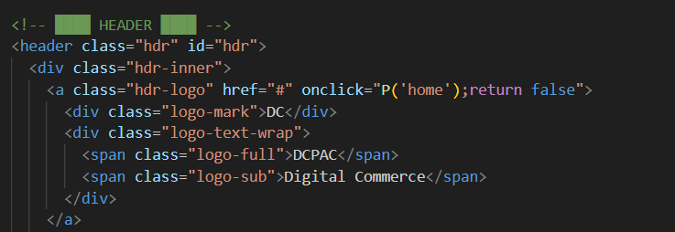
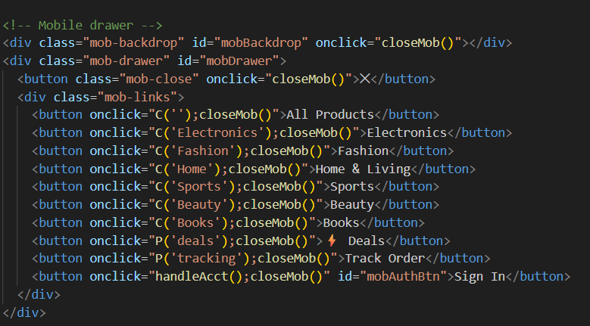
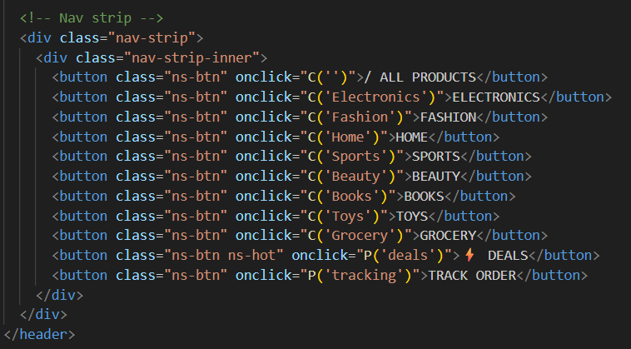
Screenshots for FWD & DSA

Slide 13
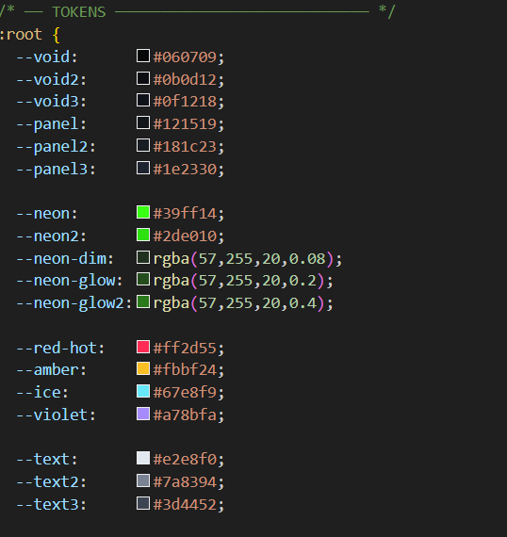
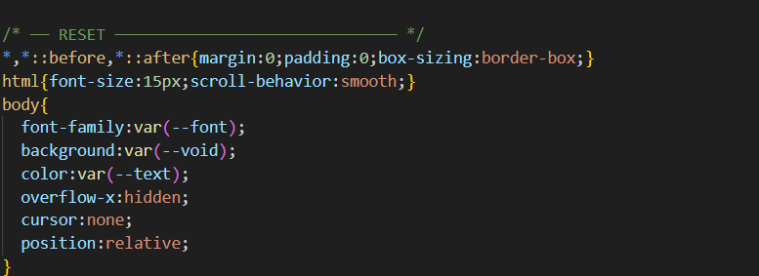
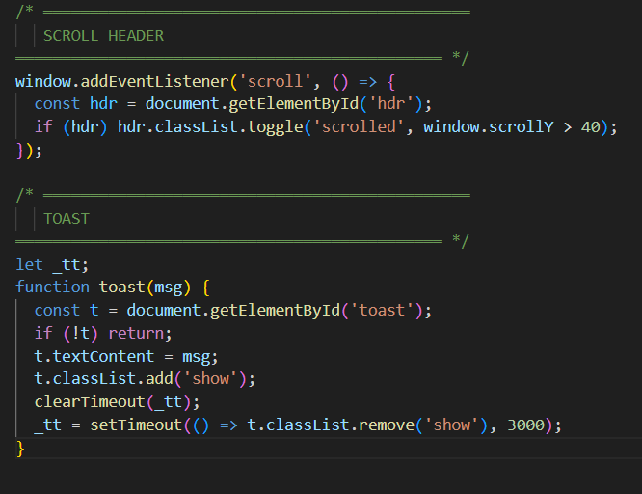

Slide 14
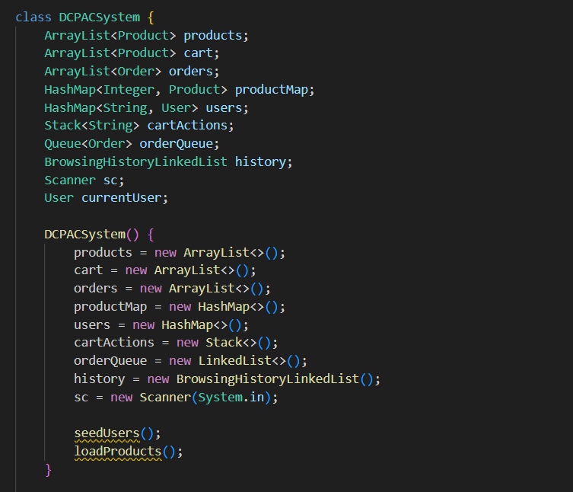
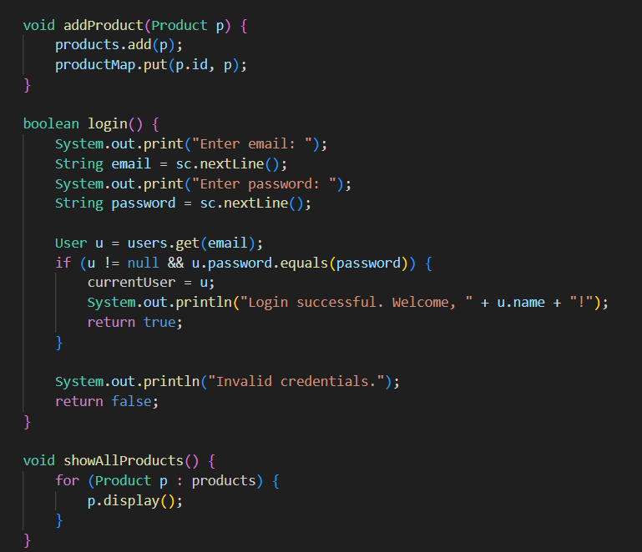
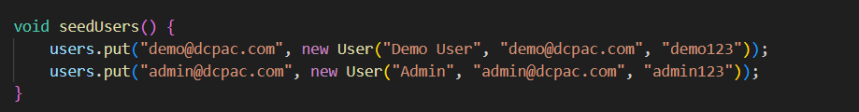

Slide 15
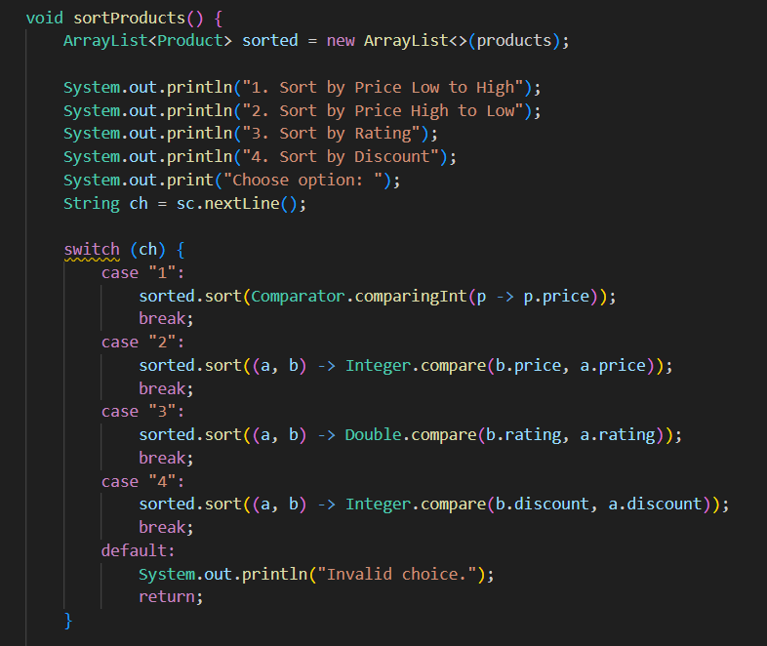
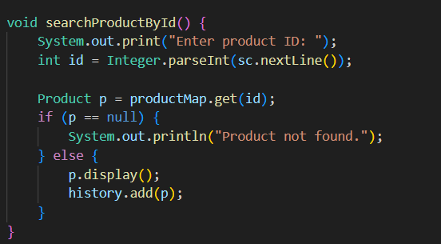
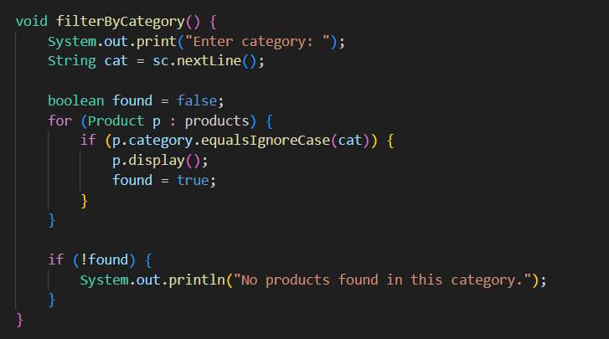

Slide 16
Conclusion
Key Achievements:
Successfully developed a production-grade, fully functional e-commerce platform from scratch using only HTML5, CSS3, and Vanilla JavaScript.
Implemented a 45-product database spanning 8 categories with CRUD, dynamic filtering, multi-sort, real-time search, and live result count.
Built a complete end-to-end purchase flow: Home → Product → Cart → Coupon → Payment → Order Confirmation → 5-step Tracking Timeline.
Applied Data Structures (Arrays, Objects, Hash Maps) and Algorithms (Linear Search, Sort, Multi-Filter, Reduce) in real-world software scenarios.
Achieved responsive design across all screen sizes with custom cursor, particle animations, hover interactions, and toast notification system.
Demonstrated all 5 Course Outcomes (CO1–CO5) of both FWD and DSA subjects through tangible, working software features in DCPAC.
Future Scope:
Node.js + Express + MongoDB backend for real server-side persistence.
Payment API integration (Razorpay/Stripe); AI-powered product recommendations.

Slide 17
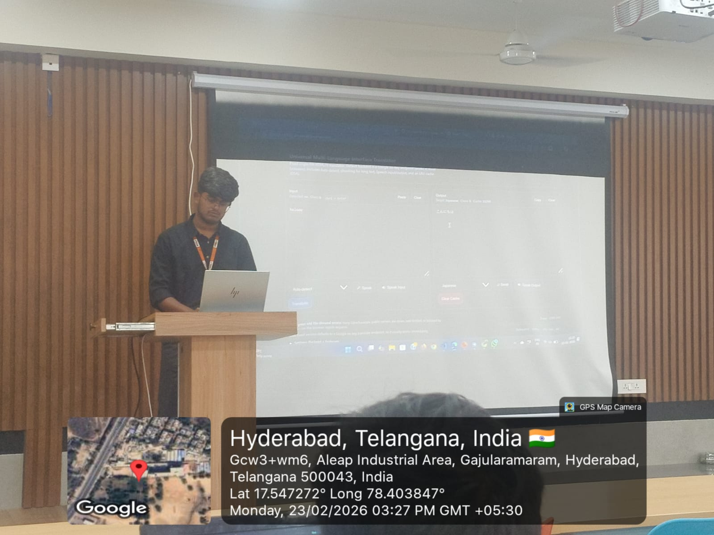
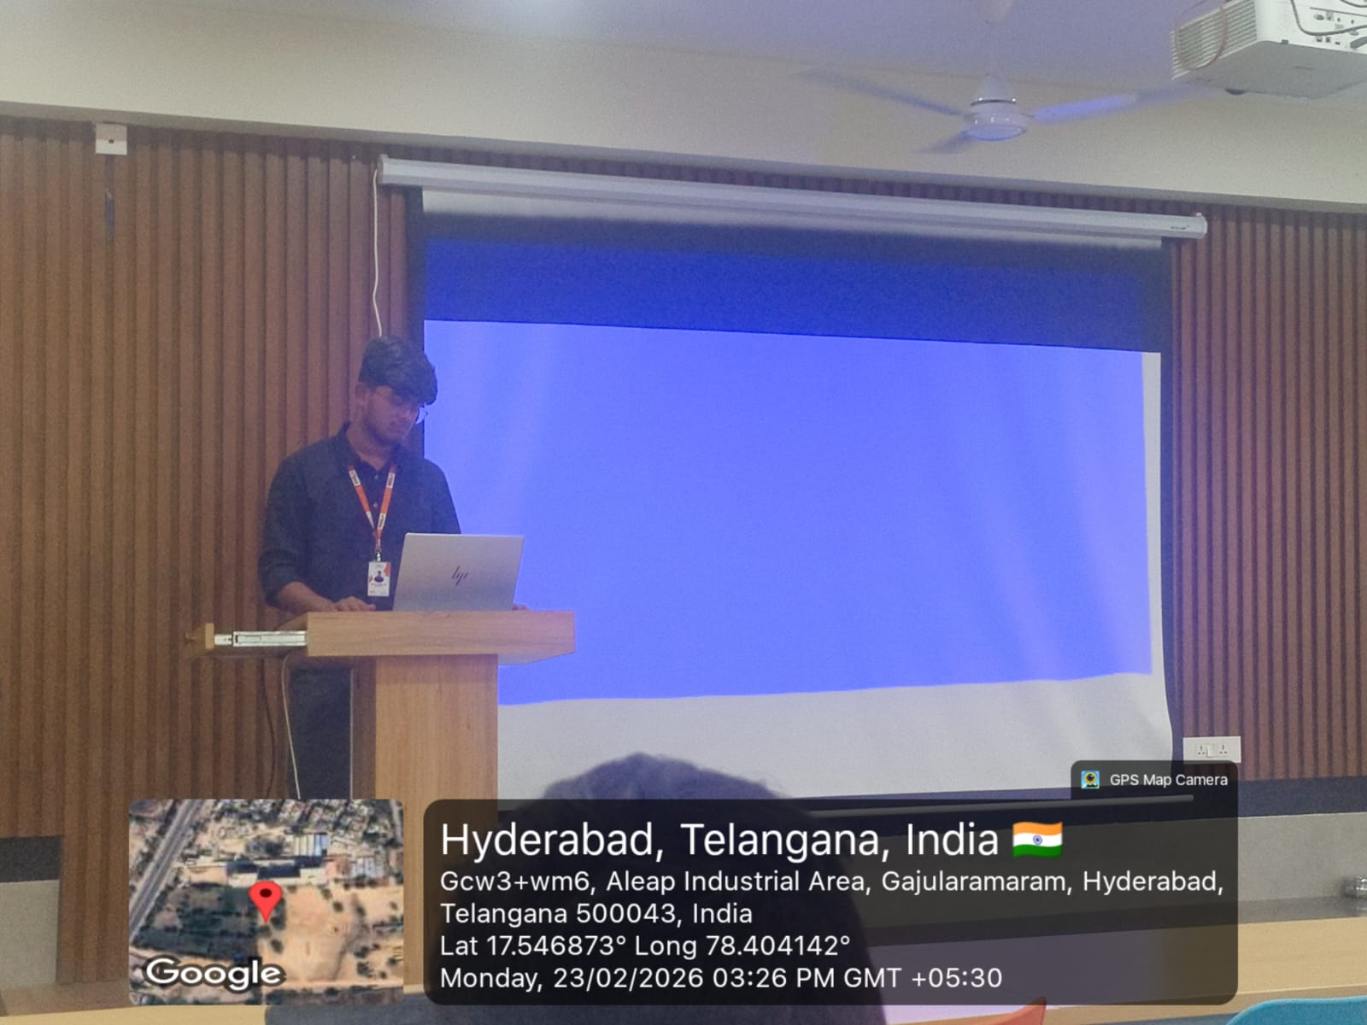
Geo- Tag Photos

Slide 18
THANK YOU

